Slide 1
Stock Prediction With Machine Learning
By,
Chethan Kacham, 700743489, CXK34890,
Sarath Chandra Nekkalapu, 700740357 SXN03570,
Durga Sai Teja Thota, 700741029, DXT10290

Slide 2
Role/Responsibilities & Contribution
Durga Sai Teja Thota: Data set representation and visualization
Chethan Kacham: Implemented Linear Regression algorithm, Kernel Ridge Regressor, Bayesian Ridge Regressor and Documentation
Sarath Chandra Nekkalapu: Implemented XGB Regressor algorithm, Support Vector Regressor and Documentation

Slide 3
Motivation
Predictions on stock markets have been the object of research for many decades.
The number of variables and sources of information that are to be considered is immense.
This makes the predictions on the stock market a hard one.
Financial news is a primary factor that investors have to consider during the process of financial decision-making.
The core of stock market prediction is to forecast the opening price of the next day.
Research scheme based on technical indicators analysis assumes that the behavior of stock has the property of predictability on the basis of its performance in the past and all the effective factors are reflected by the stock price.
By analyzing technical indicators of the previous stock price, one could obtain important information which could be explored to forecast the following stock price.
To obtain the most reliable result, we need to capture as many of these preconditions as we can. Investors make educated guesses by analyzing the data.

Slide 4
Objectives
The first and most significant stage of the research project is the business understanding, this stage is aimed at understanding the goals of the project from a business viewpoint and turning this business view into a definition of study problems and then creating a plan for achieving these goals.
The aim of this research is to find the impact of news headlines in predicting the stock market.
To forecast the market strategy, historical stock data as well as financial news is used.
So, this model was used to find whether the financial news had any influence on the stock market.
In order to maintain portability, one cannot merely rely on human labour in understanding the stock market.

Slide 5
Related work
Investors continually rebalance their investment assets to reduce decision-making risks, so they must accurately assess stock and other financial asset prices.
Due to the many factors that can affect stock prices, such as the company's asset allocation or operating conditions, economic and political policies in related industries, emergencies, and currency exchange rates, it is difficult to predict when and how to allocate asset budgets at that time (Jiang, F., Lee, J. A., Martin, X., & Zhou, G. (2019)).
Thus, many investors use technology and quantitative methods to predict asset prices.
These tactics include building a reasonable model using market data and predicting the best time to invest.
Many academics use ARIMA and GARCH time series models for forecasting, although their assumptions are high.
Stable and linear sequences are required. However, several variables affect stock data prices, making them neither steady nor linear.
Several methods can smooth the sequence, however the difference operation loses data, limiting the typical time series model's predicting ability.
Because support vector machines can interpret nonlinear data, more academics are using machine learning models for prediction as computer science and artificial intelligence advance.
The stock market reflects the economy's success and informs future economic strategies.

Slide 6
Related work
Stock investing theories include random walk, current portfolio, efficient market hypothesis, behavioural finance, and evolutionary securities.
China's ascent disproves efficient market theory.
Thus, researchers used statistical models like differentiated integrated moving average autoregression (ARIMA), generalised autoregressive conditional heteroskedasticity (GARCH), and others to better predict stock prices.
Other researchers have developed other statistical models for stock price prediction.
Due of its extensive use, experts have likened the conventional machine learning model to statistical stock price predictions.
Due to its efficient nonlinear learning and absence of assumptions, classical machine learning beats statistical models in stock price prediction. Traditional machine learning algorithms improved stock price forecasts out-of-sample.
Computer information technology is helping electronic trading handle enormous amounts of high-frequency transaction data.

Slide 7
Problem Statement
Financial organisations and regulatory bodies recognise the importance of accurate stock price projections in the stock market, where rewards and risks vary greatly. Stocks' excellent returns have attracted investors.
Stock price forecasting research never stops.
Many economists first predicted stock prices.
After studying mathematical theory and the fast growth of computer technology, it was found that mathematical models, such as the time series model, may be useful due to their simplicity and better forecasting impact.
Stock data is non-linear, hence many machine learning methods, such support vector machines, fail.
Stock prices are non-stationary and non-linear, making price predictions problematic.
Stock market projections may target price, volatility, or trend.
Computing advances led to financial market prediction system machine learning.

Slide 8
Proposed Solution
In this project, the prediction of the stock market is done by the Support Vector Machine (SVM), Bayesian Ridge Regression, Linear Regression, XGBoost Regressor, and Kernel Ridge regression.
Linear Regression:
Using linear regression, we may determine the connection between two or more variables of interest and generate predictions based on this information. There are just two variables in basic linear regression: a dependent variable and an independent variable.
XGBoost Regressor:
XGBoost enhances the Boosting algorithm based on the GBDT model, and its internal decision tree employs a regression tree. The underlying concept of the boosting method is to combine numerous weak classifiers into one robust classifier.
Kernel Ridge Regression:
Kernel ridge regression is a function approximation approach used in a regression setting. However, it is most often seen as part of a classification system using support vector machines. This nonlinear regression uses two essential machine-learning techniques. First, a ridge regression penalty enables the model to be fitted in a potentially high-dimensional nonlinear space while keeping overfitting issues in check.

Slide 9
Proposed Solution
Bayesian Ridge Regression:
The Bayesian vs Frequentist discussion is one of those intellectual disputes that I would rather observe than participate in. Rather than passionately embracing one approach of statistical reasoning, I believe it is more beneficial to study both and employ them when necessary. From a Bayesian perspective, linear regression is formulated using probability distributions rather than point estimates.
Support Vector Machine:
Support Vector Machines have supervised learning models with related learning algorithms that examine classification and regression data in machine learning. In Support Vector Regression, the needed straight line to match the data is known as the hyperplane. The goal of a support vector machine technique is to locate a hyperplane in an n-dimensional space that classifies the data points in a separate manner.

Slide 10
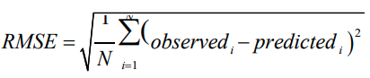
Root Mean Square Error (RMSE)
The discrepancy between the observed value and the real value may be calculated using Root Mean Square Error (RMSE). Because the average index is not robust, the average error is very susceptible to outliers. The phrase is as follows

Slide 11
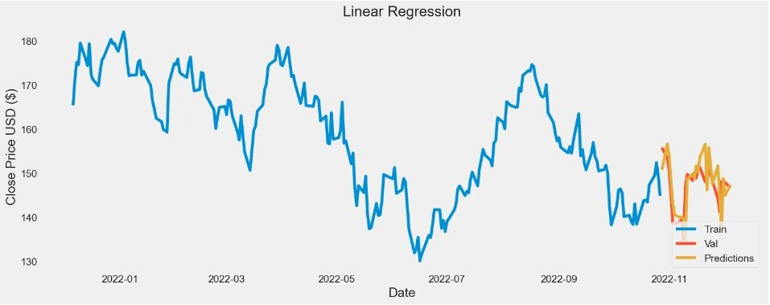
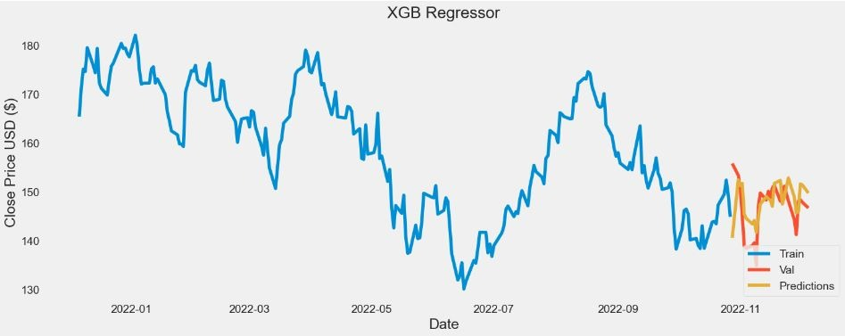
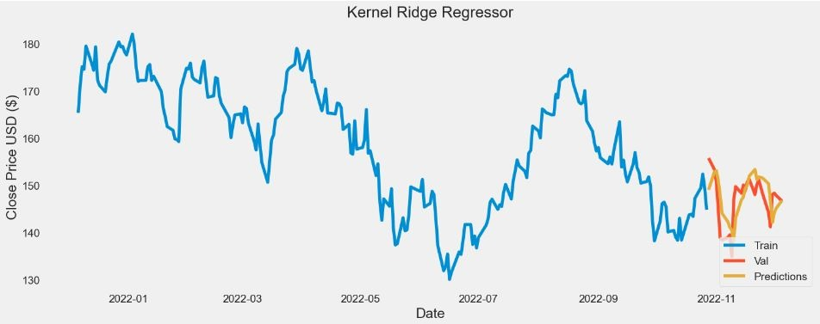
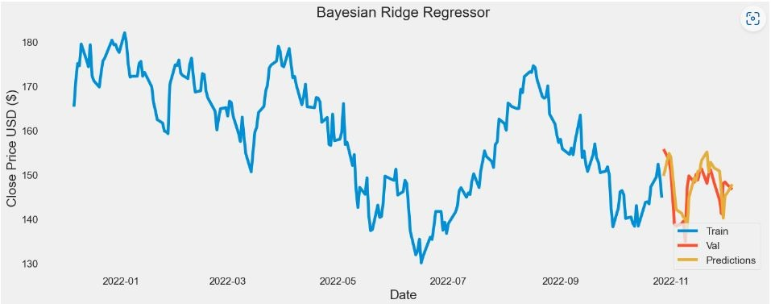
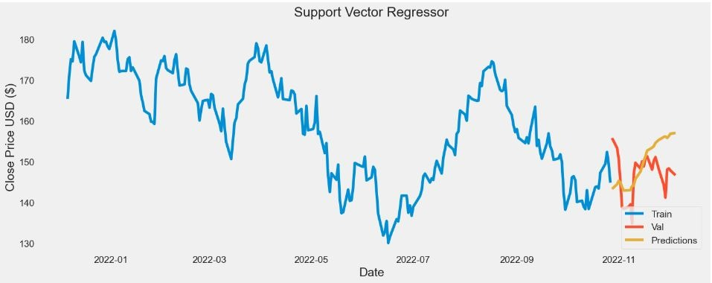
Results
Linear Regression
XGBoost Regressor
Kernel Ridge Regression
Support Vector Machine Regression
Bayesian Ridge Regressor

Slide 12
References
Chen, J., Jiang, F., & Tong, G. (2017). Economic policy uncertainty in China and stock market expected returns. Accounting and Finance, 57, 1265–1286.
Dai, Z., Zhou, H., Wen, F., & He, S. (2020a). Efficient predictability of stock return volatility: The role of stock market implied volatility. The North American Journal of Economics and Finance, 52, 101174.
Dai, Z., & Zhu, H. (2020). Stock returns predictability from a mixed model perspective. Pacific-Basin Finance Journal, 60, 101267.
Dai, Z. F., Dong, X. D., Kang, J., & Hong, L. (2020b). Forecasting stock market returns New Technical indicators and two-step economic constraint method. The North American Journal of Economics and Finance, 53, 101216.
Jiang, F., Lee, J. A., Martin, X., & Zhou, G. (2019). Manager sentiment and stock returns. Journal of Financial Economics, 132, 126–149.
Shah, D., Isah, H. and Zulkernine, F., 2019. Stock market analysis: A review and taxonomy of prediction techniques. International Journal of Financial Studies, 7(2), p.26.
Bustos, O. and Pomares-Quimbaya, A., 2020. Stock market movement forecast: A Systematic Review. Expert Systems with Applications, 156, p.113464.
Jose, J., Mana, S. and Samhitha, B.K., 2019. An efficient system to predict and analyze stock data using Hadoop techniques. International Journal of Recent Technology and Engineering (IJRTE), 8(2), pp.2277-3878.
Hu, Z., Zhao, Y. and Khushi, M., 2021. A survey of forex and stock price prediction using deep learning. Applied System Innovation, 4(1), p.9.

